Slide 1

PERSONAL ALBUM
Project Number-23
Course-CSE326

Slide 2

INTRODUCTION
*This will allow us to store photos in album like formation.
*We can edit photo to make it more attractive and beautiful.
*We can view them anywhere through internet by linking it by our gmail account.

Slide 3
*We can categorise each photo and store them as we want.
*It provides different options for sharing your album to social platforms.

Slide 4
BACKGROUND AND MOTIVATION
We have gone through some real life personal
album s to give our album a more realistic preview.
Our list includes Steve McCurry, Ansel Adams,
Sebastiao Salgado and many others.

Slide 5
OBJECTIVE
Its main objective is to make a personal
album interface where the user can easily save their personal and important pics.
The Project is made with the knowledge of basic Html and css but to add some special features in the project we had used some special features from different resources.

Slide 6
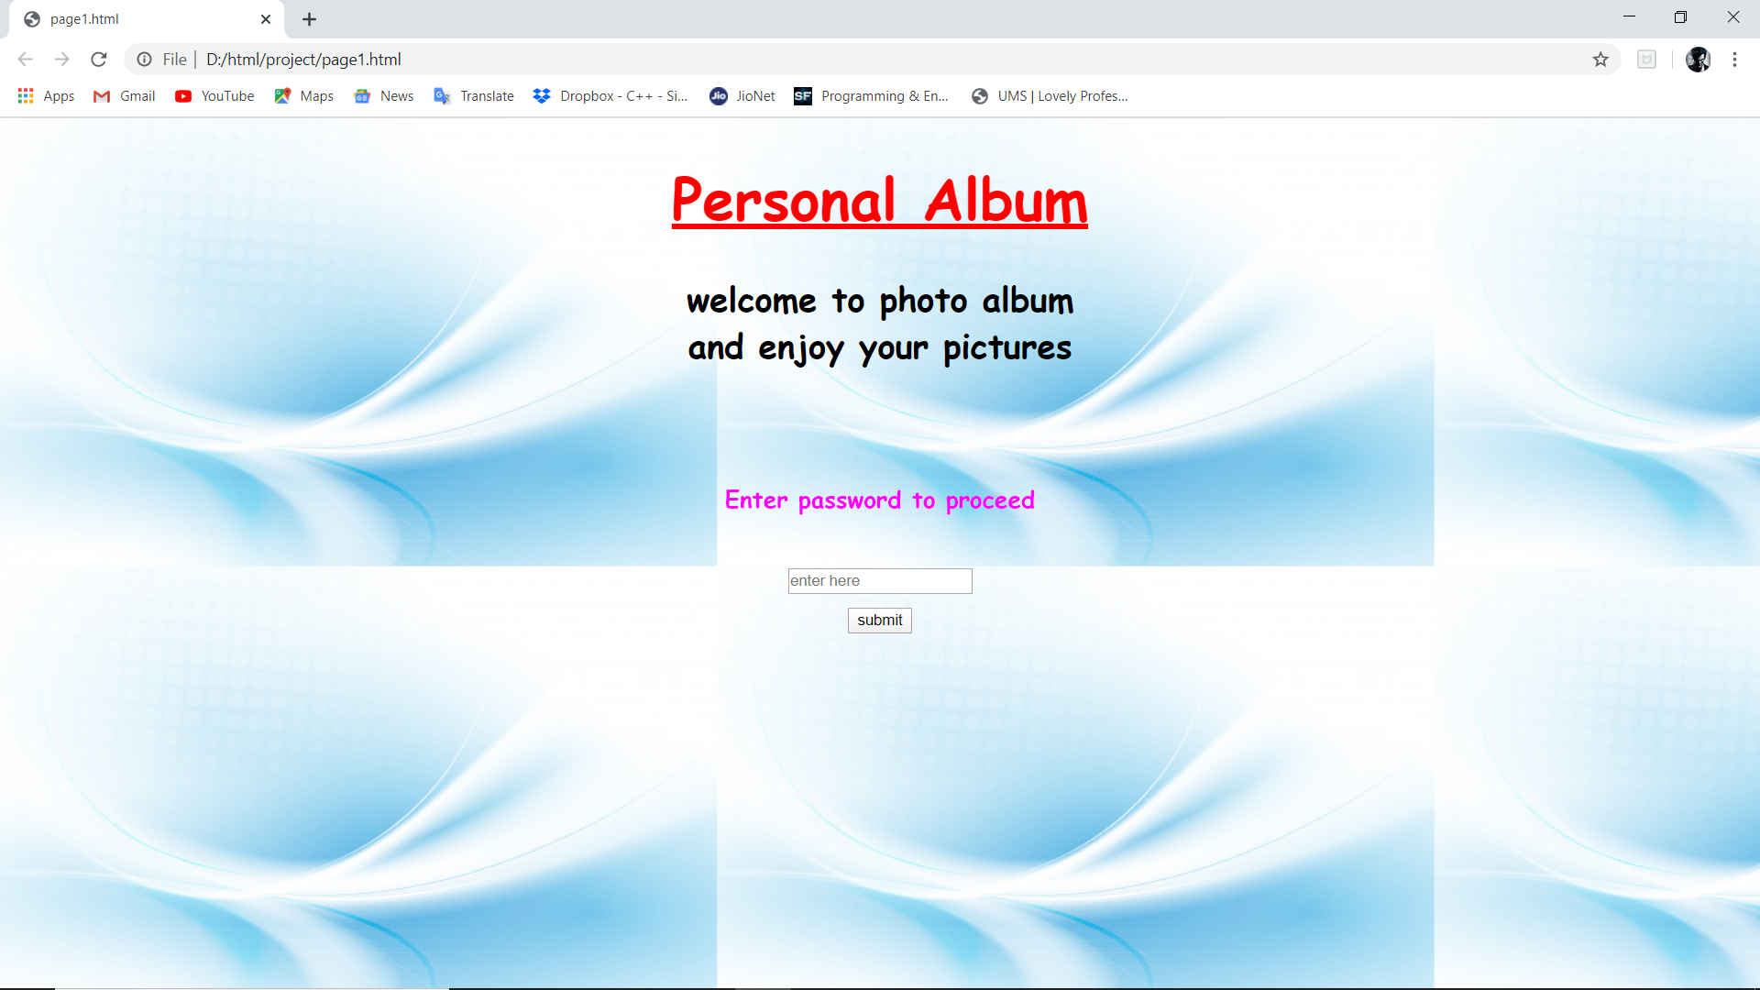
Layout

Slide 7
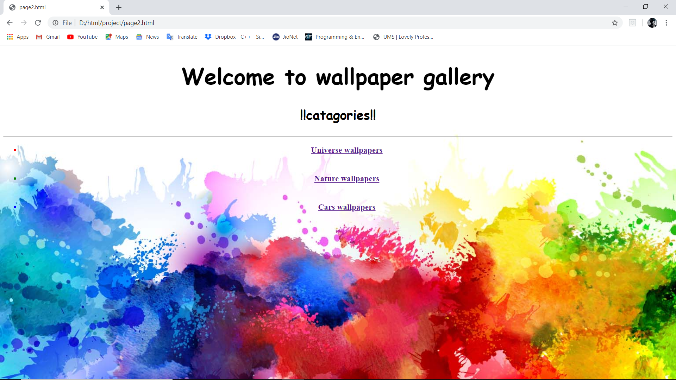
Album Outlook

Slide 8
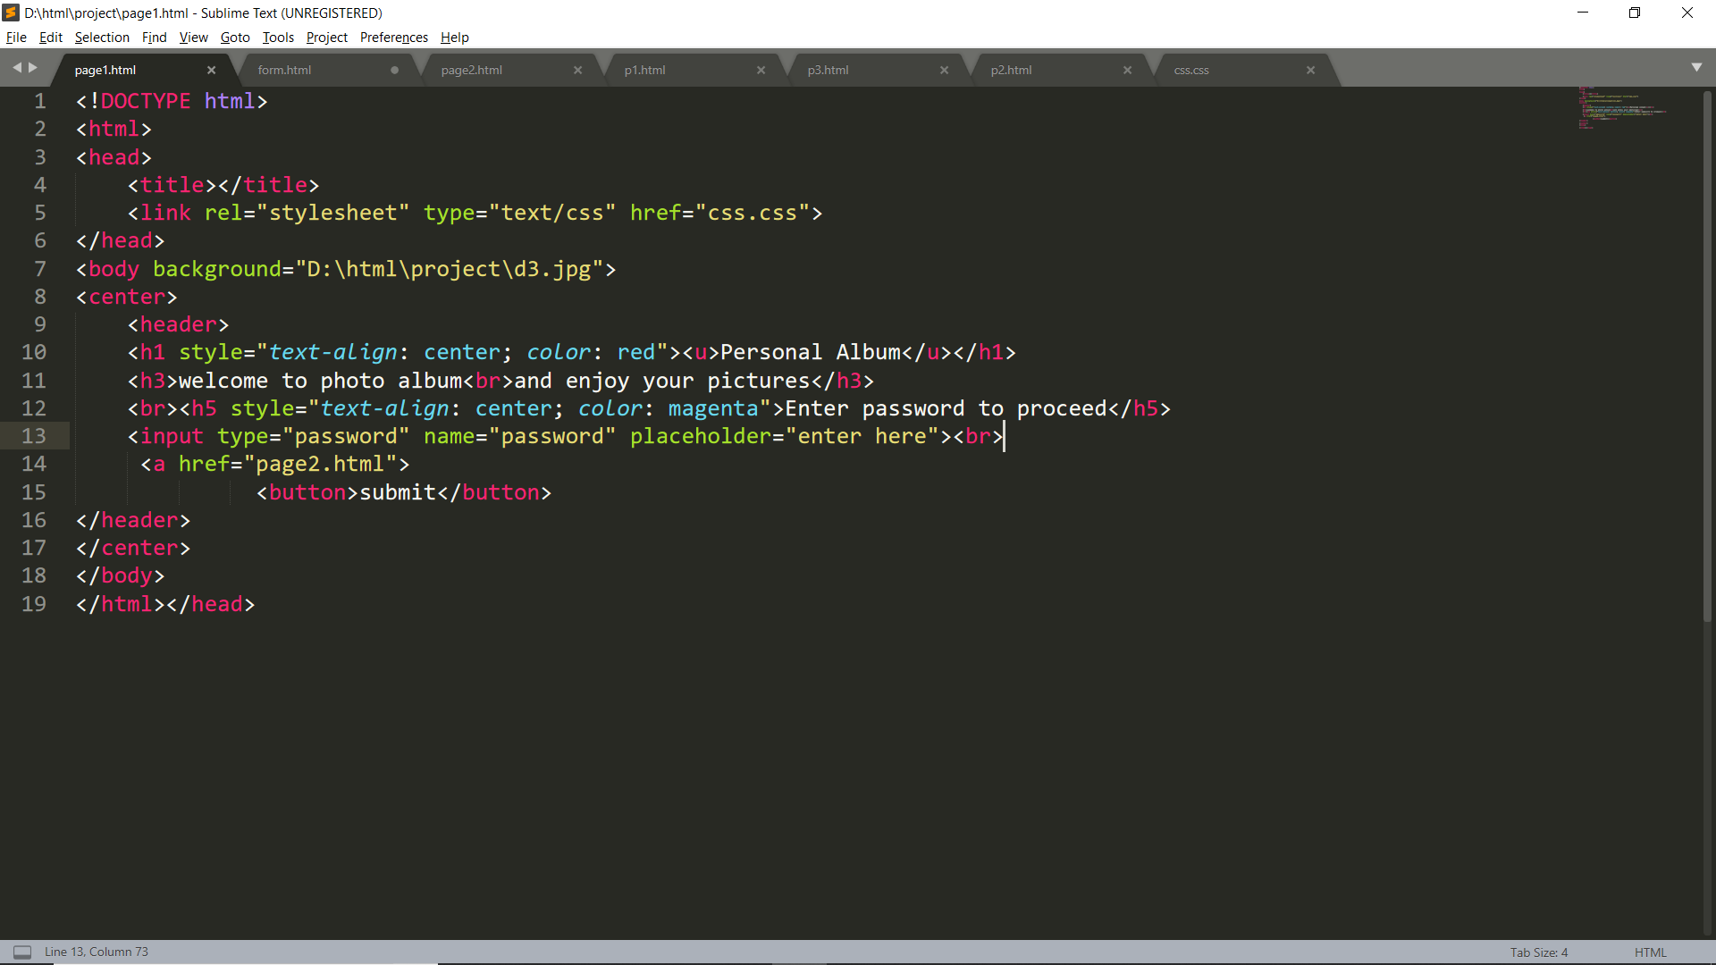
DESCRIPTION
Some of the pictorial representation of project.

Slide 9

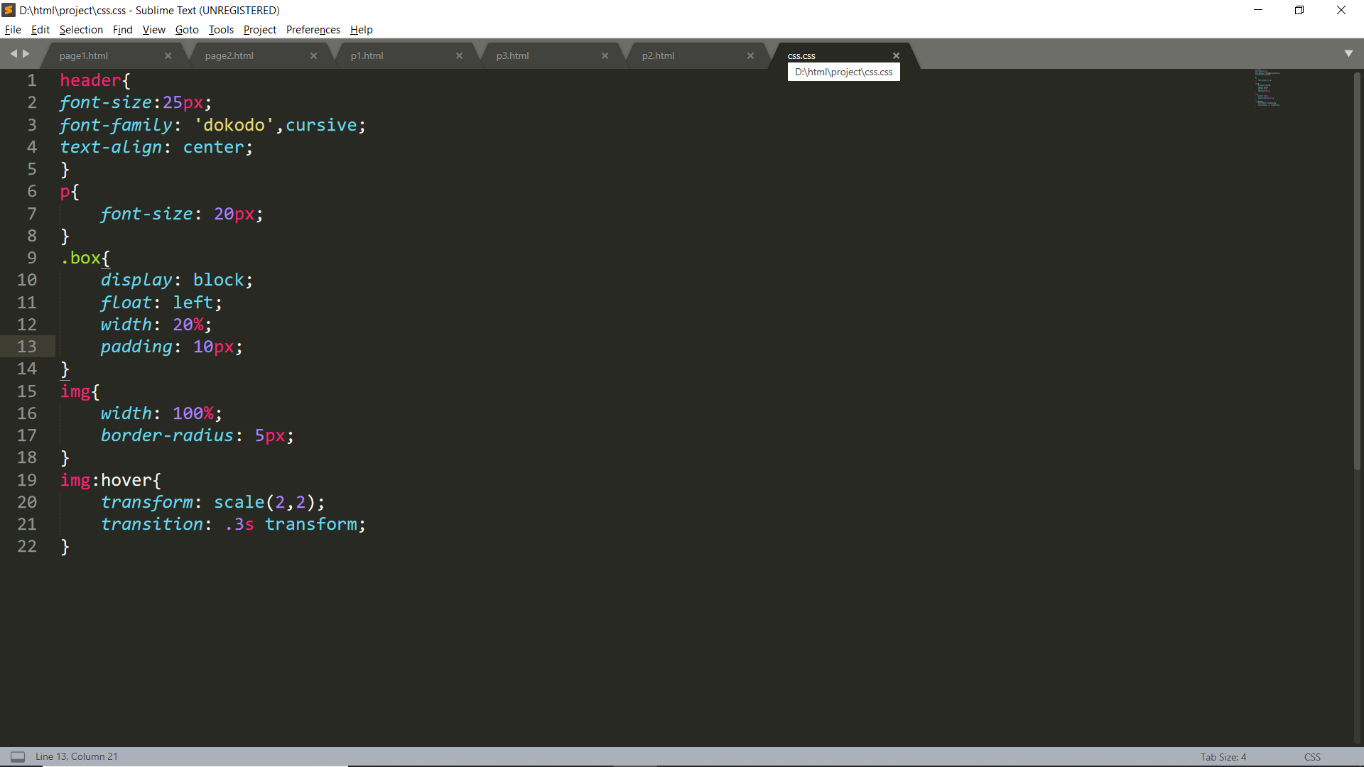
DESCRIPTION
The styling segment of project.

Slide 10
CONTRIBUTION
With full of dedication and interest all of us contributed equally ,
Aman and Nimit were the part of coding and Uday was collecting info about how we can make our website more exciting and easily accessible.
Working on this projects was a good time and a great journey of getting knowledge

Slide 11
TECHNOLOGY
The entire code for the project has been written using Sublime Text.
We are using HTML5 and CSS(Hyper text mark up language and Cascading style sheet respectively).A little of bootstrap has been also used.
The program has been run using Google Chrome and Mozilla Firefox.

Slide 12
SUBMITTED BY
NAME | ROLL NO | REGISTRATION NO | SECTION
Aman patel | 13 | 11903120 | K19DE
Nimit jain | 15 | 11903077 | K19DE
Uday Kiran | 14 | 11903069 | K19DE

Slide 13


